Slide 1
PCB Assembly

Slide 2
The PCB Assembly Process
Apply solder paste with a stencil
https://learn.adafruit.com/smt-manufacturing/squeegees
Place parts
Reflow in an oven
Solder on through-hole components.

Slide 3
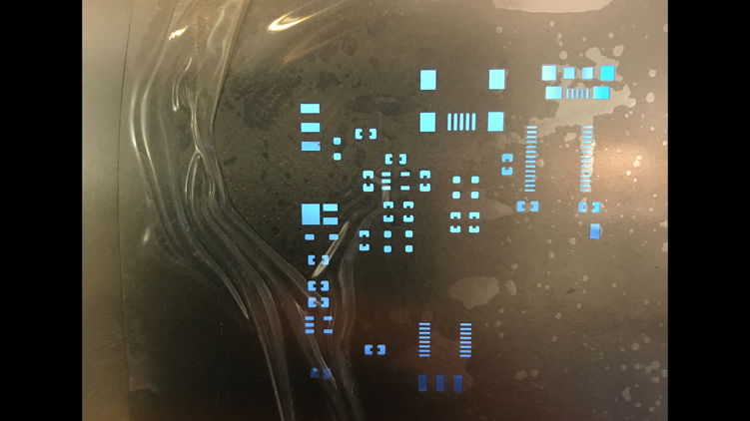
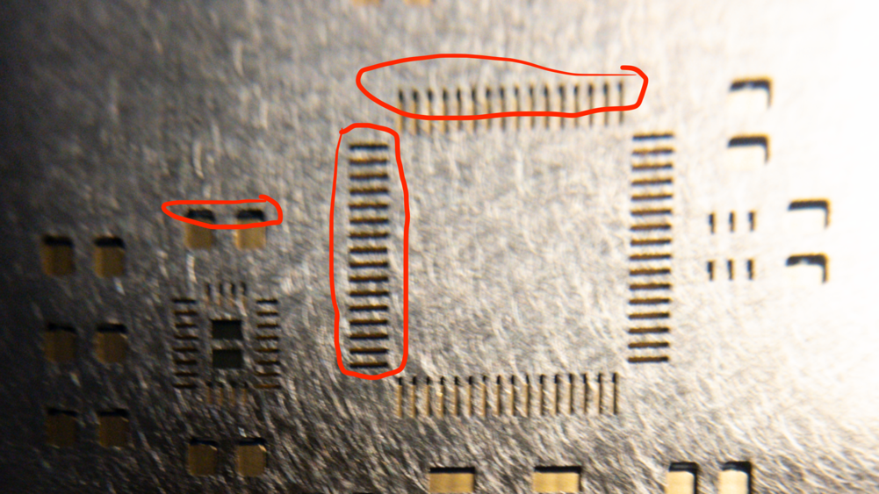
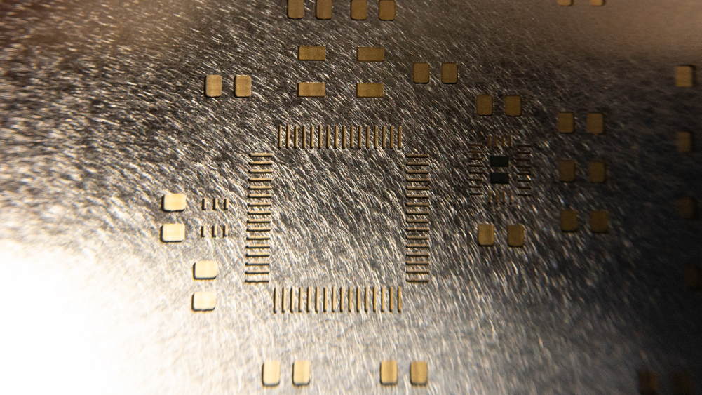
Align Stencil
Bad
Good

Slide 4
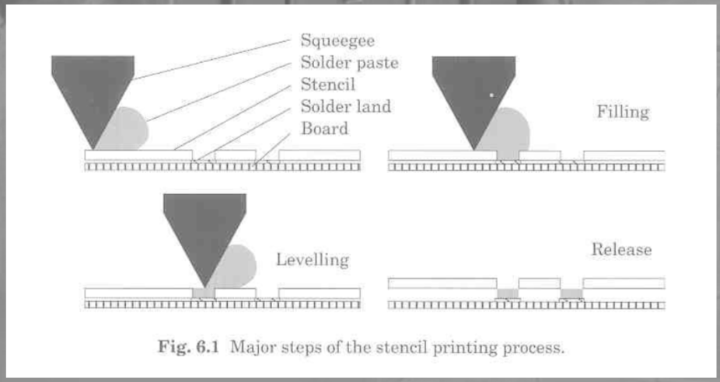
Solder Squeegees

Slide 5
Our “squeegee”
Photos: Adafruit.com

Slide 6
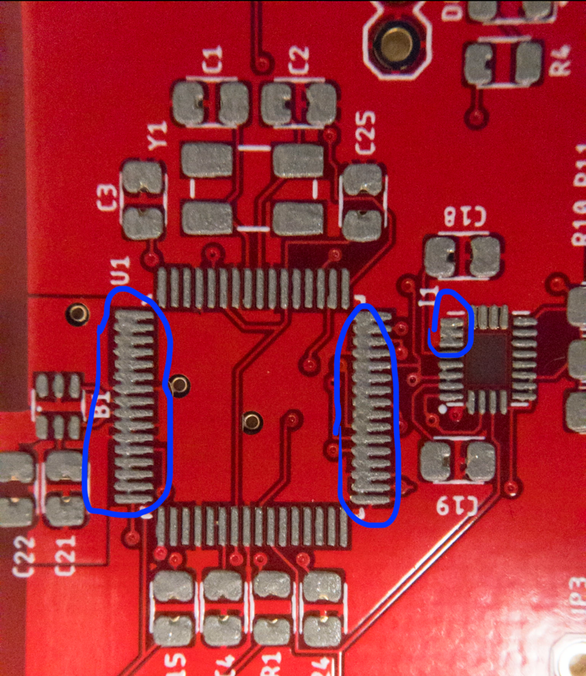
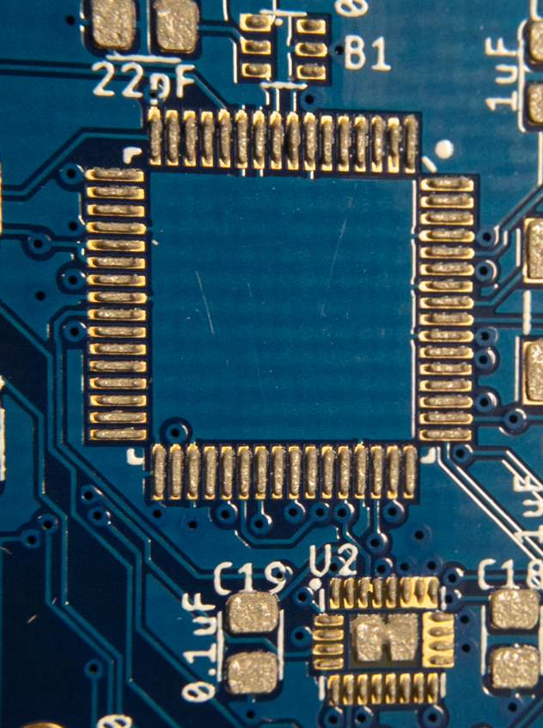
Applying Solder Paste
Bad
Good

Slide 7
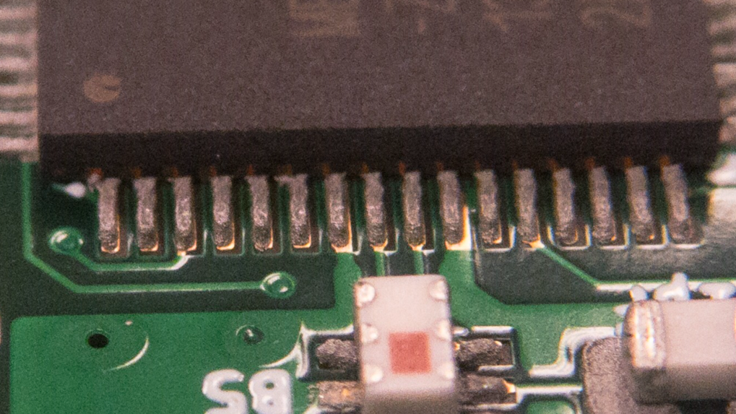
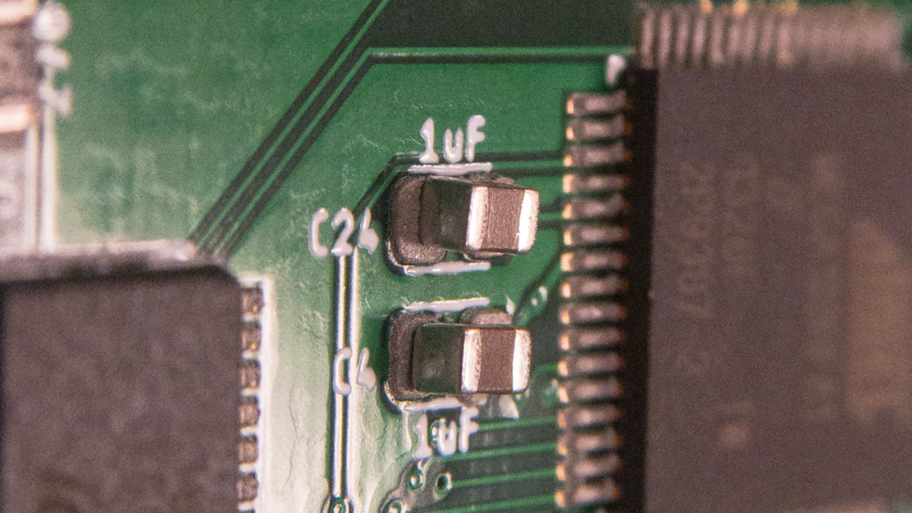
Part Placement
Good
Good

Slide 8
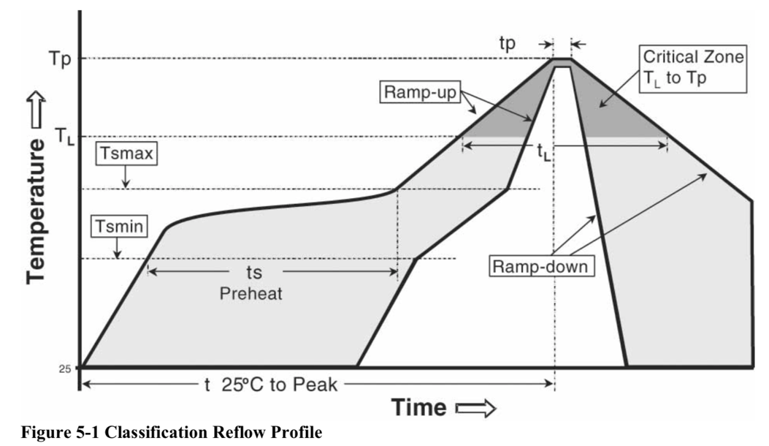
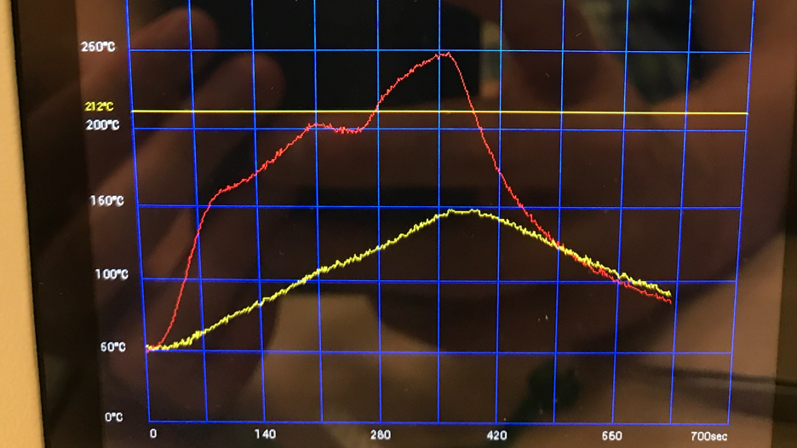
Reflow Soldering

Slide 9
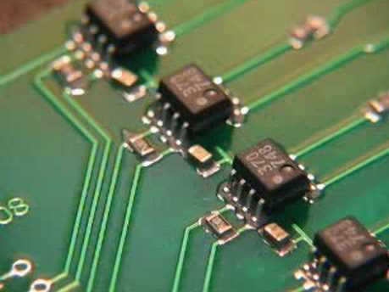
Reflow Video

Slide 10
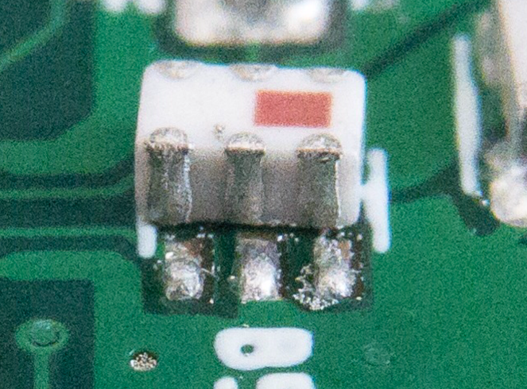
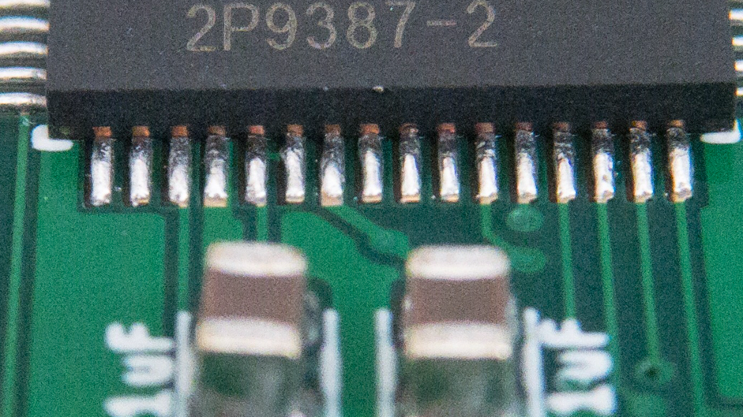
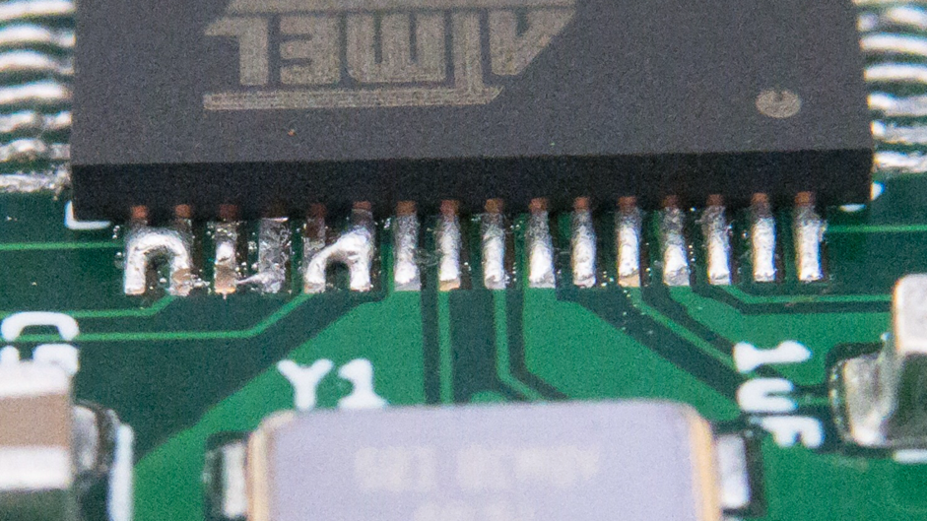
Reflow Soldering Results
Good
Bad

Slide 11
Solder Joints

Slide 12
Process For the Lab: Collect parts, apply paste
Collect parts
Grab 1 packet of each type of part.
They are laid out in the lab.
Do not open them until you are ready to place them.
Apply paste
Read lab write up carefully.
Wear gloves
Check stencil alignment
Put paste on squeegee
Apply!
Check it yourself
Get it checked by staff

Slide 13
Process For the Lab: Place parts
Place parts in order given in lab write up.
Some parts are not used on the BBB.
Open packets of parts one at a time
Tips
Double check values (e.g., “1uF”) to ensure proper placement
Double check orientation on diodes, LEDs, the micro controller, and the balun.
Don’t fiddle.

Slide 14
Process For the Lab: Reflow and Touch Up
Course staff will run boards through the reflow oven in batches
Check boards for solder bridges and other problems.
If touch up is necessary, staff will guide.

Slide 15
Process For the Lab: Throughhole Parts
There are a few throughhole parts
Headers
Power terminals
Tape them in place with blue tape
Staff will demo throughhole soldering.

Slide 16
Process For the Lab: Bring Up
First, check for shorts between power and ground
Flash bootloader
Borrow the ISP programmer.
Follow lab instructions to flash the bootloader.
Run test code
BlinkTest.ino should blink an LED.
Test the radio
Run test_remote_harness.ino on your board.
Run test_remote.ino on your remote.
Demo it working for the course staff
Due date
End of lab, 1 week after you start.

Slide 17
TODO
Add slides for:
Problems with IMU pads being in accessible.

Slide 18
TODO
Add slides for:
Flow chart/illustrations of assembly process.
Side view of board + paste + component.
Problems with IMU pads being in accessible.

Slide 19
Videos
https://www.youtube.com/watch?v=cnAFTMaS5R0

